Slide 1

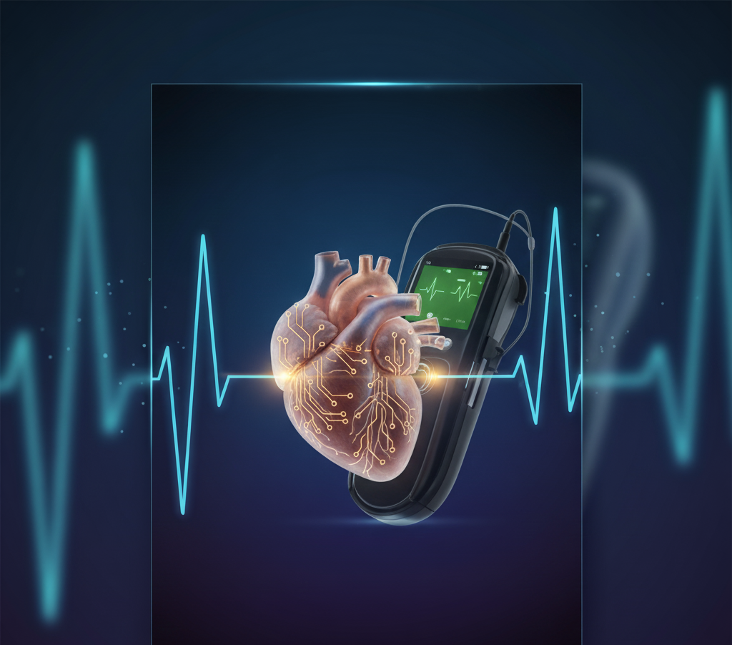
VIBEAITHON 2025
AI-Powered Smart Health
Monitoring and Early Disease Detection System
AURA-AI: Autonomous & Ubiquitous Remote-monitoring for
Advanced AI-powered Health

Slide 2
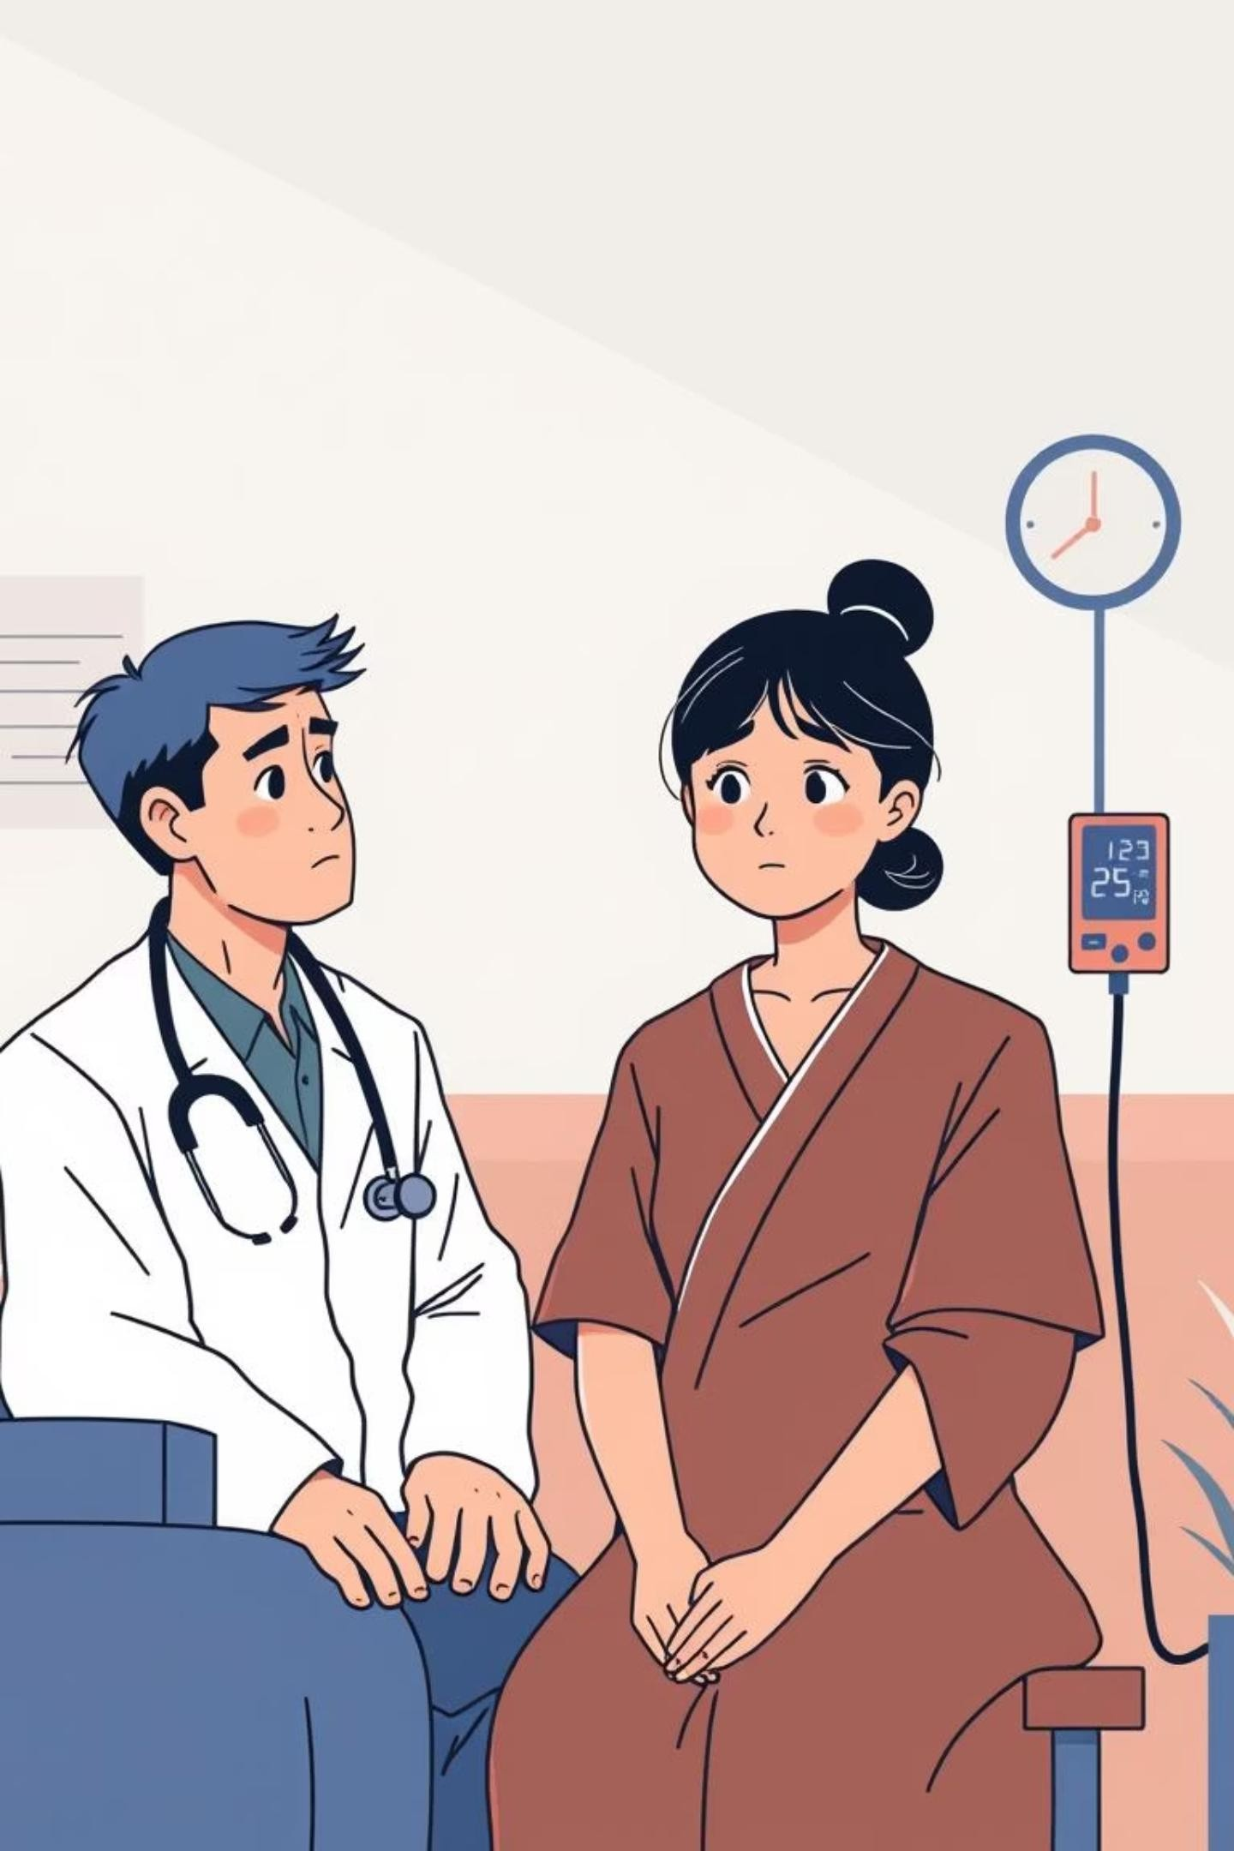

The Problem:
Bridging the Healthcare Gap
Despite advancements, accessible and continuous health monitoring remains a critical challenge, especially in remote and underserved areas. Early disease detection can save lives and reduce healthcare burdens.

Slide 3
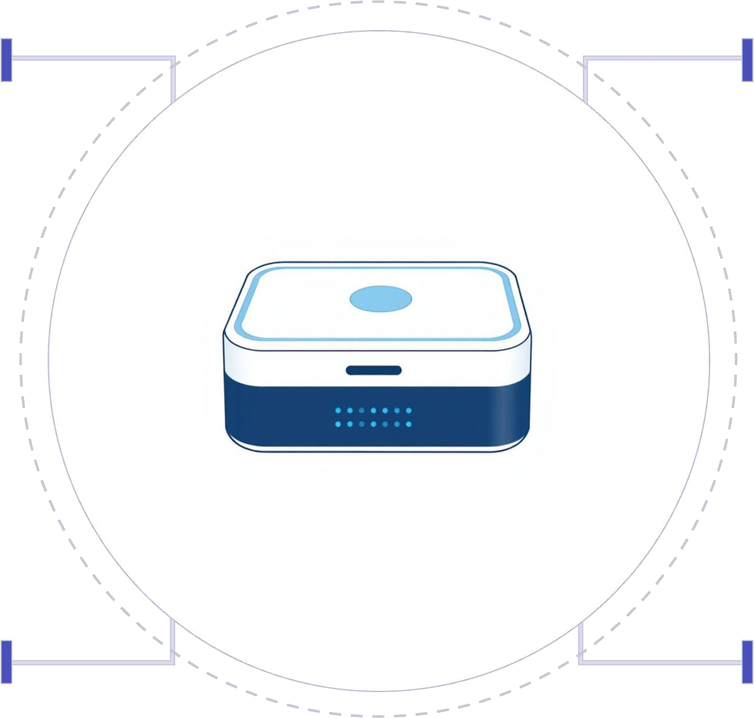
AURA-AI: Your Portable Health Companion
Our solution is a compact, AI-powered health box designed for Autonomous & Ubiquitous health monitoring.
ECG
SpO2
AD8232 sensor for heart
rhythms
MAX30102 oxygen and pulse
MQ135 detects pollutants
Skin temp and cuff-less PTT
Air Quality
Temp & BP

Slide 4


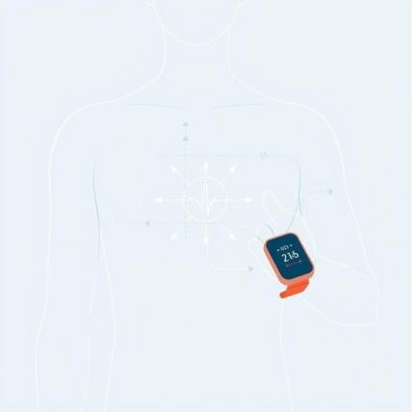
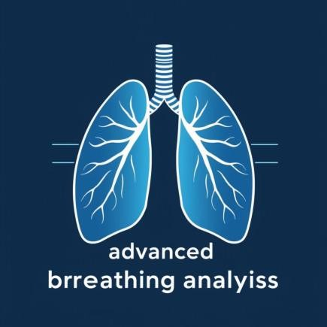

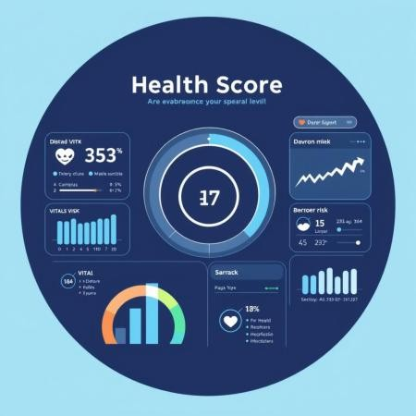
INNOVATION & EDGE: WHY AURA-AI STANDS OUT
Cleaner ECG Signals
On-Device Cardiac Detection
Cuff-less Blood Pressure
Advanced noise reduction for precise cardiac data.
Real-time analysis at the edge for immediate insights.
Comfortable, continuous BP monitoring without a cuff.
Smarter Breathing Check
Vitals Forecasting
Personalized Risk Index
Advanced analysis for respiratory patterns and health.
Predictive health analytics and early risk assessment.
A comprehensive, dynamic assessment of individual health risks.

Slide 5






TECHNICAL APPROACH: FROM SENSOR TO CLOUD
Methodology Flow
Key Components
Sensor Fusion
Collect ECG, SpO₂, PPG, respiration (accelerometer), temperature, and environmental data simultaneously.
Hardware
Signal Processing
Apply real-time filters, QRS detection, and PTT calculation for clean ECG and cuff-less BP trends.
Multi-Parameter
Analysis
Combine HR, SpO₂, BP, respiration, and environment → generate health status insights.
ESP32 & Raspberry Pi
AD8232 (ECG)
MAX30102 (SpO₂)
MQ135 (Air Quality)
User Interface
Interactive dashboard with ECG waveform, BP trend, SpO₂, and respiration graphs in real time.
Cloud & Alerts
Auto-upload to ThingSpeak; instant alerts sent to caregivers/doctors via Telegram during abnormalities.
Software
Python, TensorFlow Lite
ThingSpeak (Cloud)
Telegram API (Alerts)

Slide 6






CHALLENGES & MITIGATION
Our team successfully navigated several technical hurdles to ensure AURA-AI's reliability and precision.
AD8232 ECG Electromagnetic Interference
The AD8232 ECG modules experienced significant electromagnetic interference, causing noisy and unreliable signals.
Fix: We employed advanced digital filtering techniques and ensured proper grounding of
the circuitry to eliminate interference, leading to cleaner ECG signals.
MAX30102 SpO₂ Module Errors
Initial MAX30102 SpO₂ modules purchased in India had PCB errors. This led to inaccurate
readings and instability.
Fix: We performed board-level soldering to correct the traces and implemented careful
calibration procedures to ensure accurate SpO₂ readings.
Hardware Validation
Ensuring the accuracy and reliability of sensor data required robust hardware validation against known standards.
Fix: Validation was performed using accelerometer swing tests for motion artifacts and
SpO₂ skin resistance tests for precise calibration, ensuring data integrity.
SpO₂ Noise Spikes
Sporadic noise spikes in SpO₂ readings disrupted data consistency, making continuous
monitoring challenging.
Fix: Median filtering was applied to the SpO₂ data stream, effectively smoothing out
transient noise spikes without losing critical information.
BP Accuracy (PTT-based)
Achieving reliable cuff-less blood pressure measurements based on Pulse Transit Time (PTT) presented an accuracy challenge.
Fix: The PTT-based system now provides continuous trend monitoring, offering insights into BP changes, with optional cuff calibration for personalized baseline accuracy.
Optimized Sampling Rate
An unoptimized sampling rate could lead to either data overload or loss, impacting cloud
integration and real-time analysis.
Fix: We meticulously optimized the sampling rate to balance data fidelity with efficient
and stable cloud integration, preventing data loss.

Slide 7
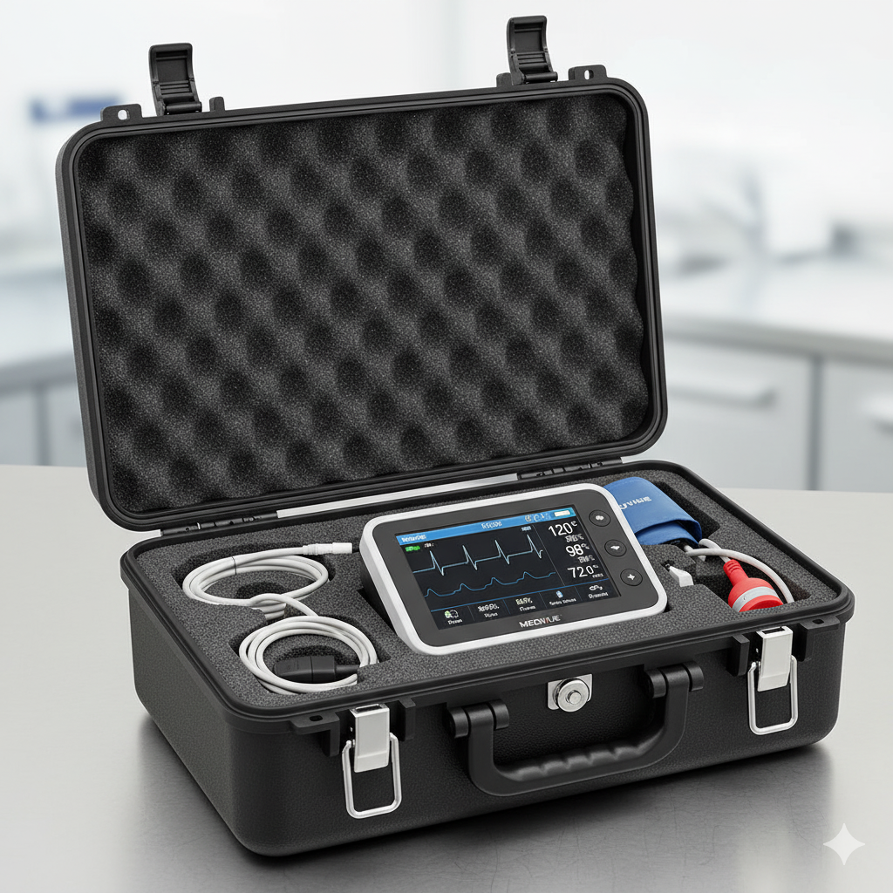
Desirability
Target users: Rural clinics, ambulances, elderly-care homes, and home-based patients.
Pain point solved: Eliminates need for multiple costly instruments and continuous manual monitoring
User validation: Early prototypes tested with biomedical datasets and live signals show reliable ECG and SpO₂ trends; doctors confirm usability for primary-care screening.

Slide 8

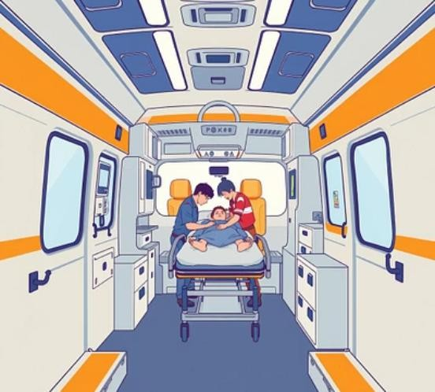

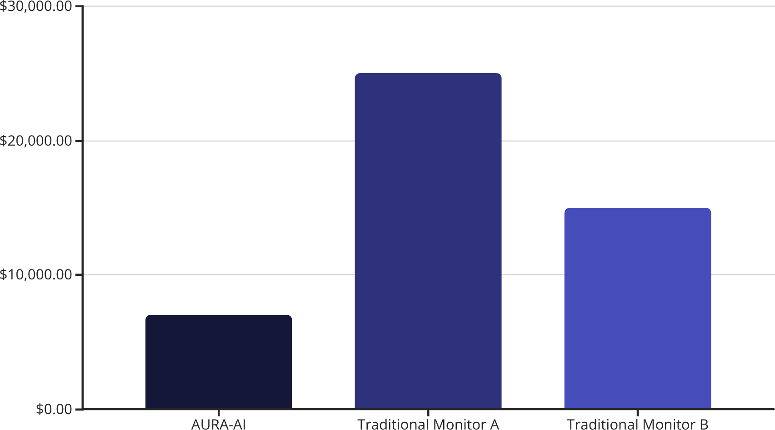
FEASIBILITY & VIABILITY: A PRACTICAL SOLUTION
FEASIBILITY:
It uses low-cost, widely available modules (ESP32, AD8232, MAX30102, accelerometer, Pi 4)
Built on open-source frameworks (Arduino, Python, TensorFlow Lite, ThingSpeak, Telegram API)
VIABILITY:
Prototype-ready: Hardware assembled, tested with datasets + real signals.
Future-ready: Strong path to TRL upgrade, medical-grade sensors, and
regulatory approvals (ISO/CE).
DEPLOYMENT ENVIRONMENTS:
Our system is designed for broad applicability:
Seamless integration into clinics, emergency services, and home care.
ECONOMIC VALUE:
Affordable alternative to expensive bedside monitors.
Portable design makes it deployable in homes, ambulances, and mobile health units
Scalable platform: Expandable to Cloud Dashboards,
telemedicine networks & wearables.
Supports National Digital Health Mission and aligns with UN SDG Goal 3
(Good Health & Well-being).

Slide 9
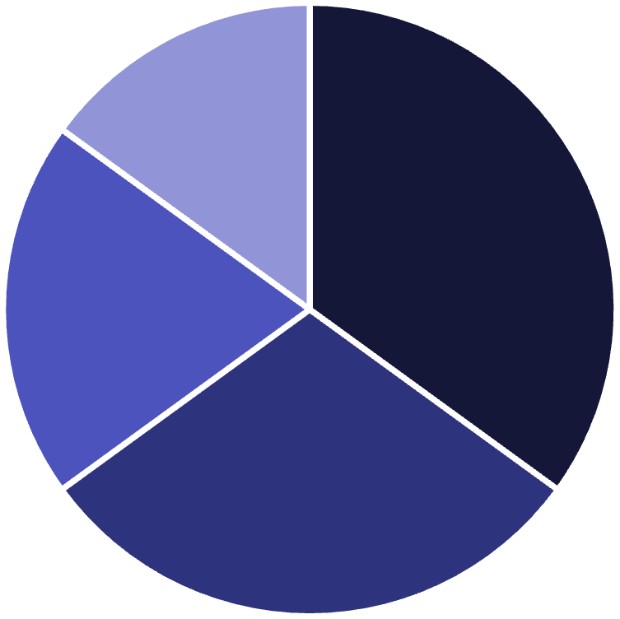




IMPACT & BENEFITS: TRANSFORMING HEALTHCARE
Clinical Impacts
Early Risk Detection
Proactive intervention for critical conditions.
Continuous Monitoring
Rural Patients
Elderly
Chronic Illness
Emergency Services
24/7 health oversight for peace of mind.
Targeting diverse segments for maximum health impact.
Data-Driven Insights
Personalized healthcare through intelligent analytics.

Slide 10
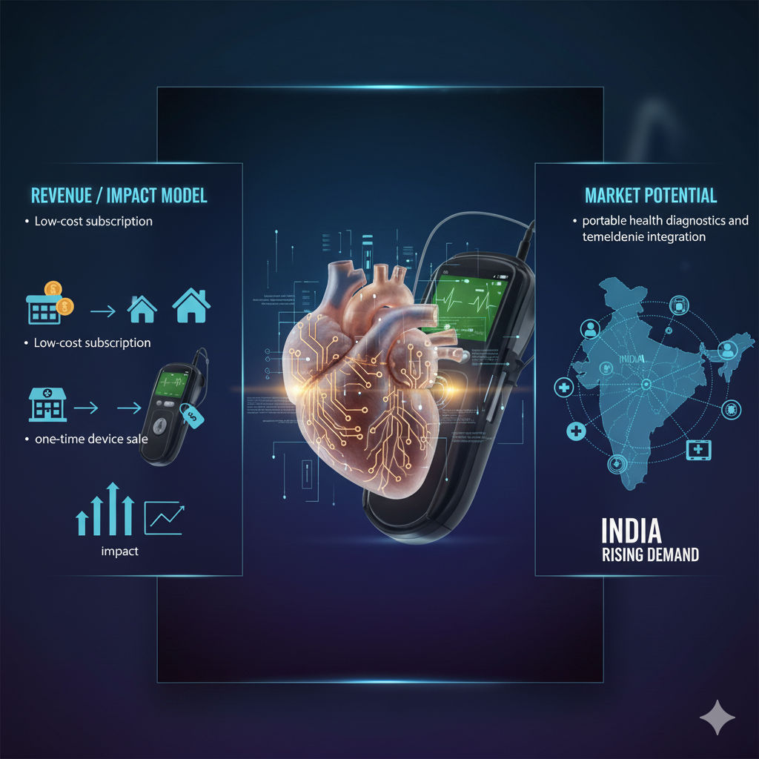
Viability
Revenue / Impact Model: Low-cost subscription or one-time device sale for clinics and home users.
Market Potential: Rising demand for portable health diagnostics and telemedicine integration across India.
Scalability: Modular design allows future wearable version; supports integration with NDHM / Aarogya Setu Health Stack.
Cost: Estimated below ₹2,500 per unit in mass production.

Slide 11
Prototype

Slide 12
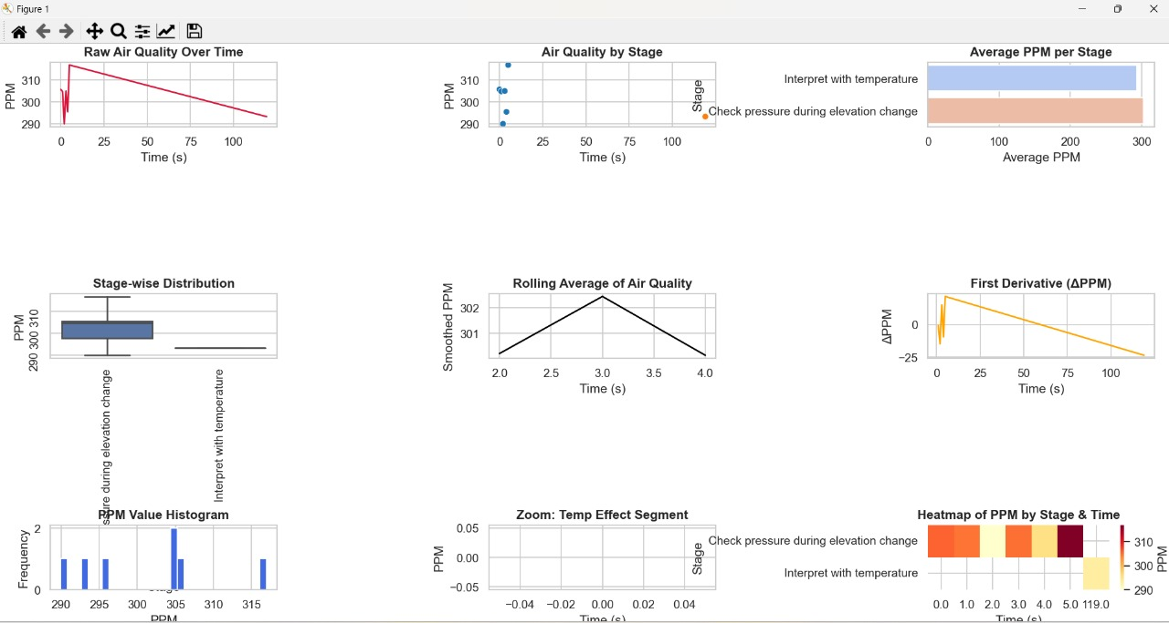
Prototype

Slide 13
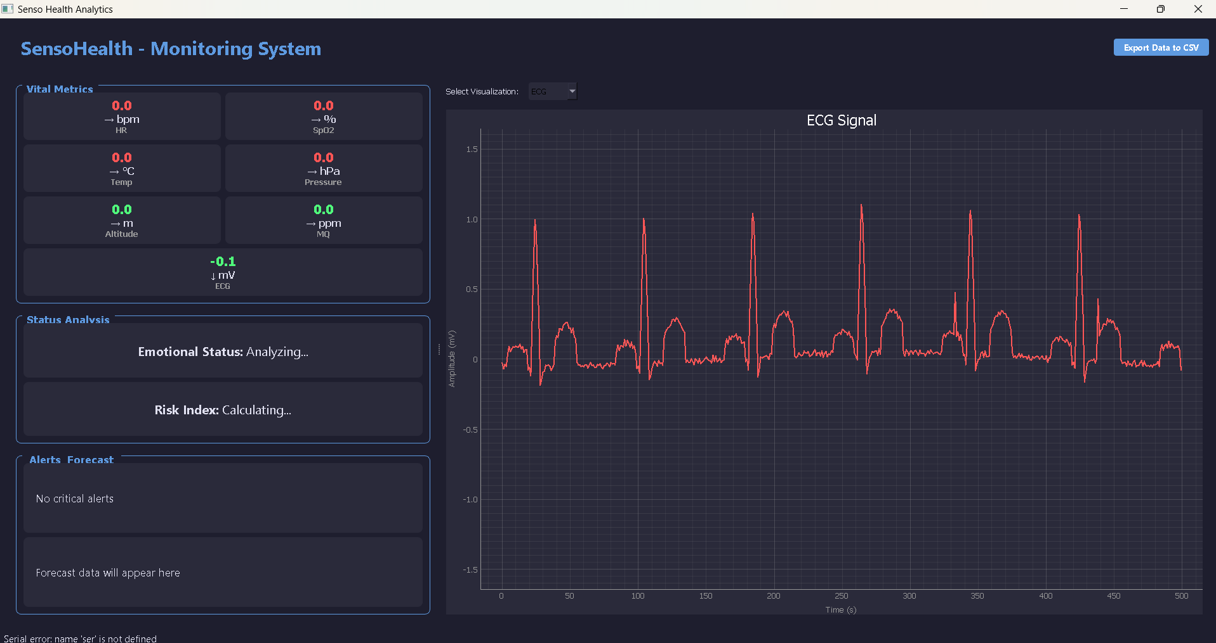
Prototype

Slide 14
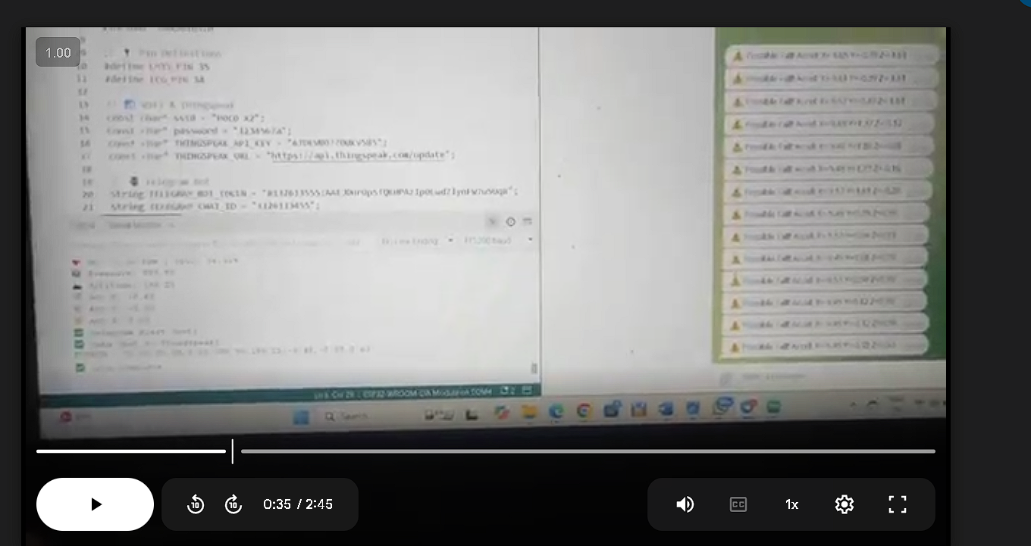
Prototype
Working features video
LINK: https://drive.google.com/file/d/16Ad1lGwIH42pDH1Y6s1ycDH8BzEPEF2q/view?usp=sharing

Slide 15
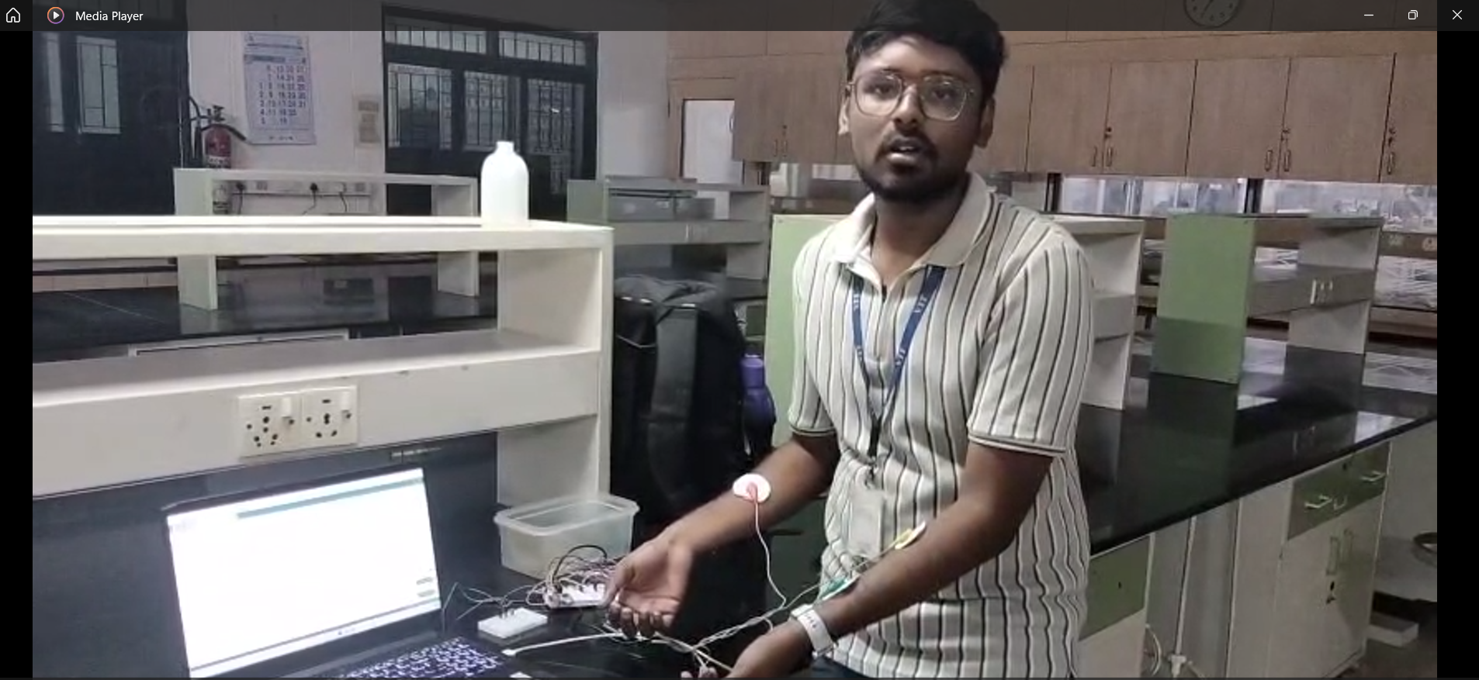
Prototype
Demonstration video
LINK: https://drive.google.com/file/d/1oahr23VaH1ktzGe77dklZe2Q2VhNCi7k/view?usp=drive_link

Slide 16
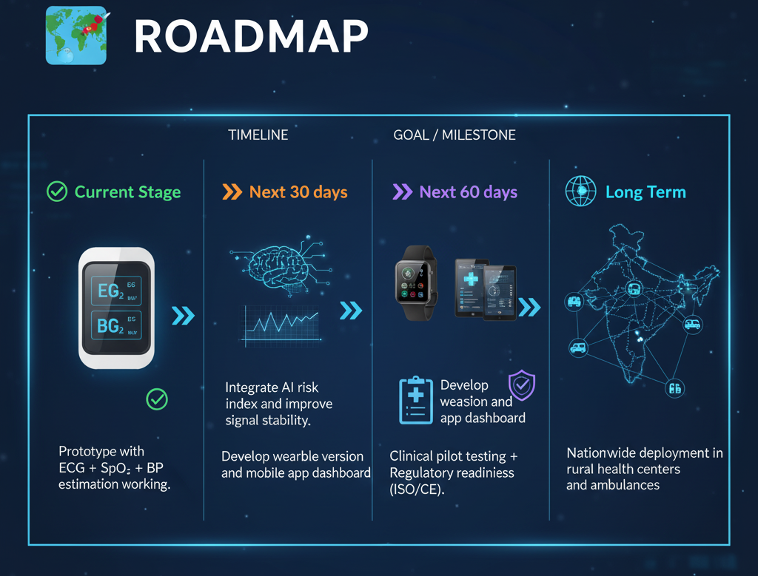

Slide 17
Team & Roles
Name: Abisek Sasikumar
Role: Solo Developer & Researcher
Skills & Expertise:
Embedded Systems (ESP32, Raspberry Pi)
Biomedical Sensor Integration (ECG, PPG, MQ sensors)
Signal Processing (ECG filtering, PTT estimation)
Machine Learning & Deep Learning (TensorFlow Lite, 1D-CNN, LSTM)
Cloud & IoT Integration (ThingSpeak, Telegram API)
Data Visualization (Python, PyQtGraph, Matplotlib)
Why I Can Complete This Project: With a background in Electronics, Sensors, and AI-based Health Monitoring, I have hands-on experience building and testing multi-sensor biomedical systems and implementing real-time AI inference on embedded platforms. The complete prototype is already functional and ready for further optimization.

Slide 18
ASK
Mentorship: AI model validation and medical data calibration support.
Partnerships: Collaboration with biomedical research labs or hospitals
.
Funding: For hardware optimization and wearable-scale production.

Slide 19

RESEARCH & DEVELOPMENT
Key References & Resources:
ECG & PQRST Analysis: MIT-BIH Arrhythmia Database (ECG datasets)
Cuff-less Blood Pressure (PTT): Blood Pressure Estimation Based on Photoplethysmography for Personalized Healthcare
Respiration Monitoring (PPG + Accelerometer):
"Respiratory Rate Monitoring Using PPG Signals" – Journal of Clinical Monitoring & Computing
ADXL345 datasheet & biomedical motion studies
Environmental & Multi-Sensor Fusion:
Bosch BMP280 Environmental Sensor White Paper
•MQ-135 Gas Sensor for Air Quality Studies
Explore our progress and code:
HEARTWARE

Slide 20

Abisek S
Linkedin:
https://www.linkedin.com/in/abisek-sasikumar-42a89327a/
Email:abiseksasikumar@gmail.com
Mobile No:9080991640

Slide 21
Thank You
Together, we can build a healthier India.

